Slide 1
Real World Exercise Wearable Applications:
Running Through with Crowd Sourcing
American College of Sports Medicine
Mid-Atlantic Region
November 6, 2022
Garrett Bullock, PT, DPT, DPhil
Wake Forest University School of Medicine

Slide 2
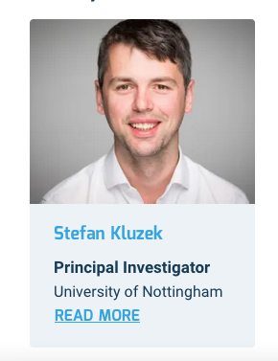
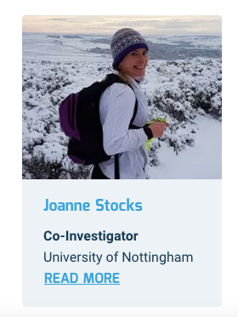
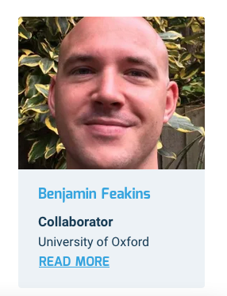
Many Thanks to the International Team

Slide 3


Slide 4




Slide 5
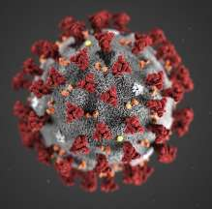

Slide 6



Slide 7



Slide 8
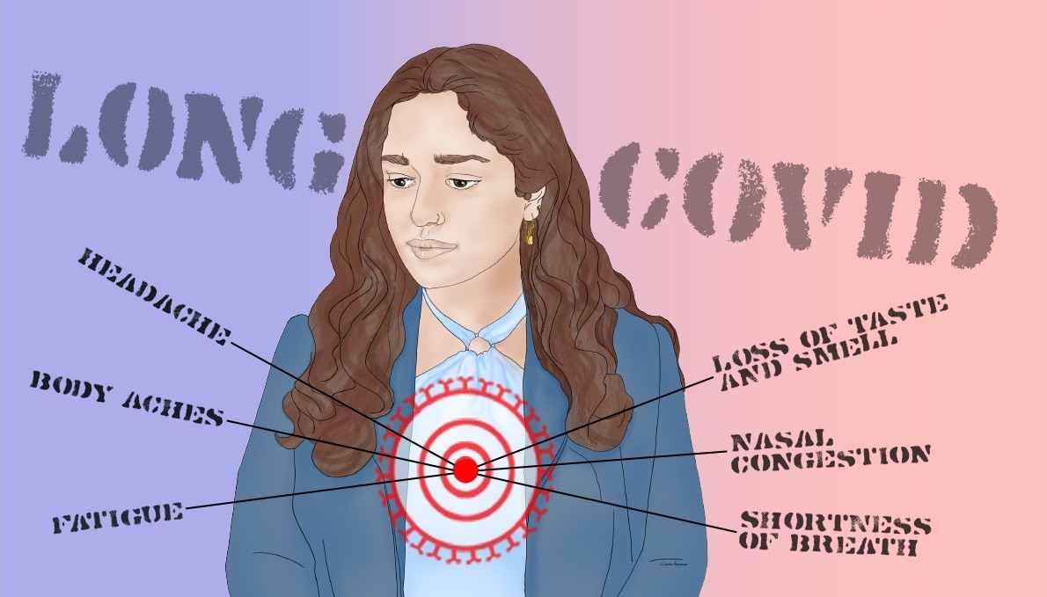

Slide 9


Slide 10


Slide 11
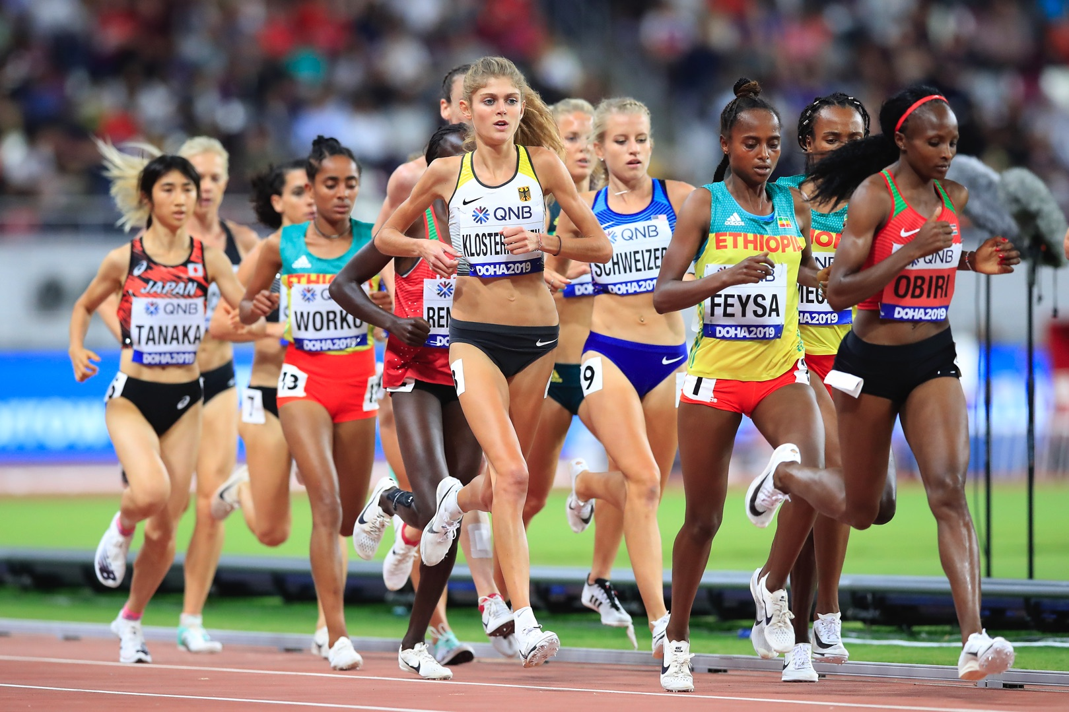
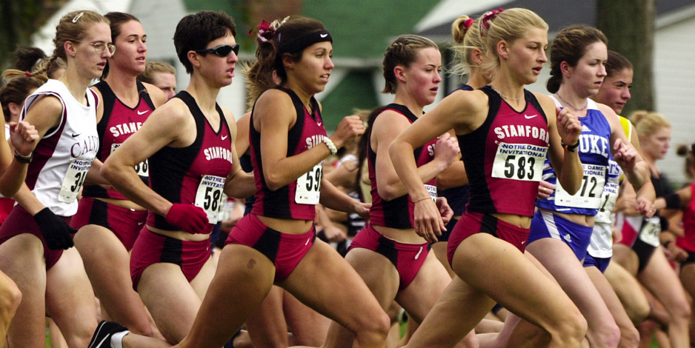
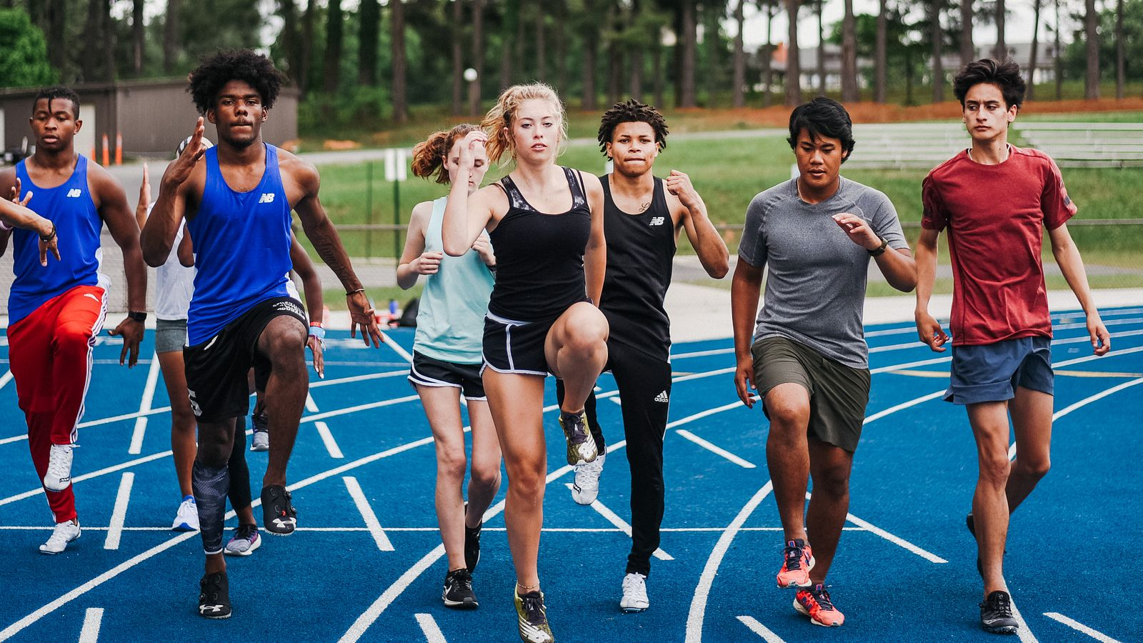
Not Generalizable to Population

Slide 12
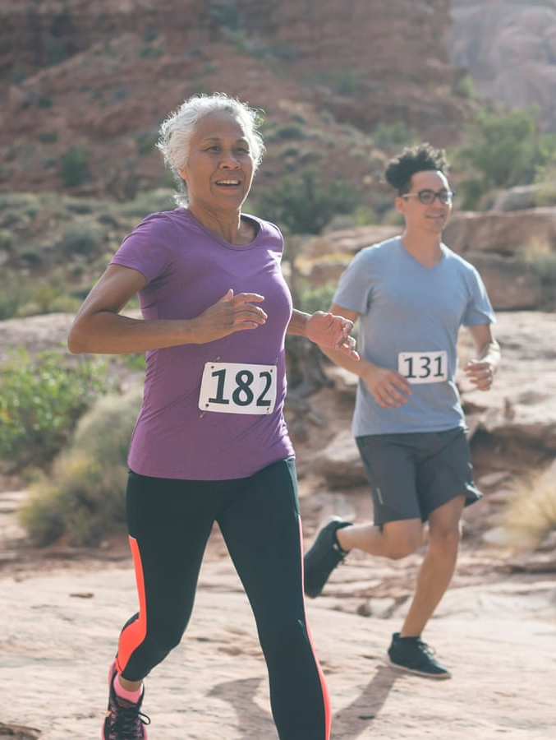
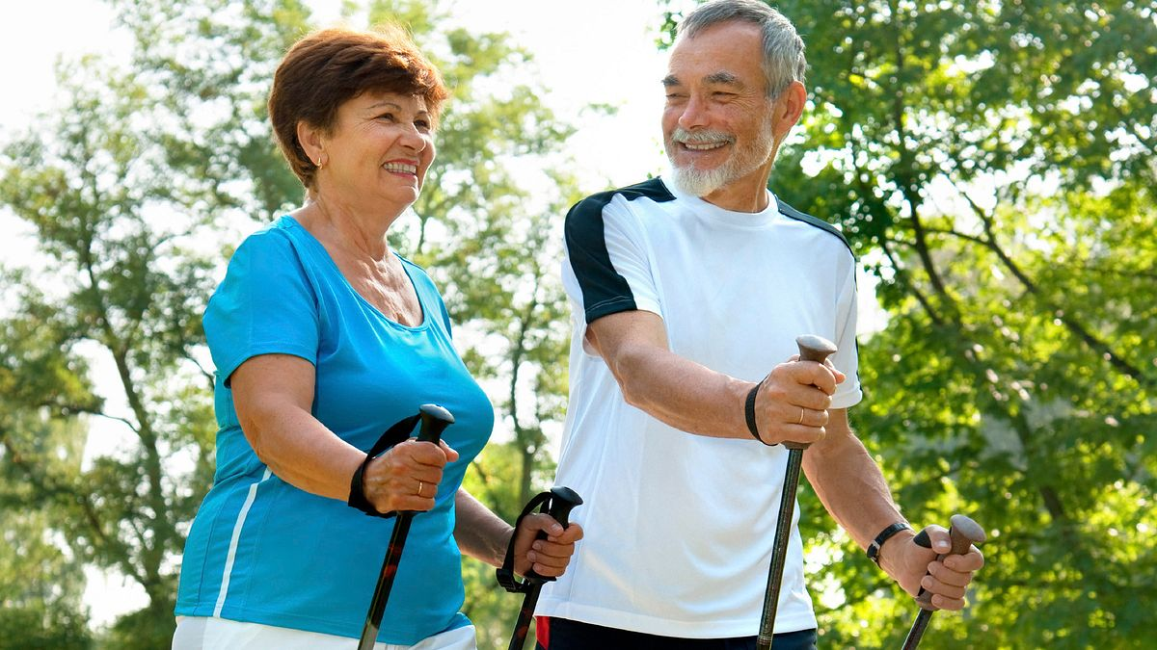
Want to Focus on All Ages, Abilities & Background

Slide 13


Slide 14
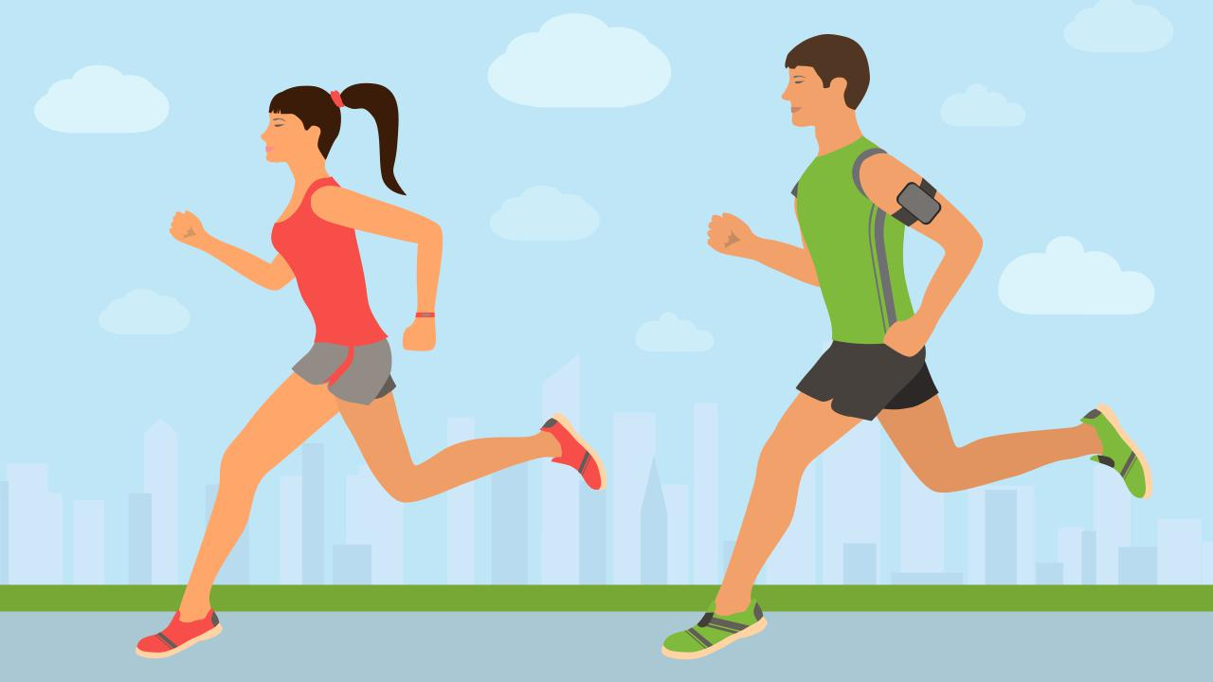
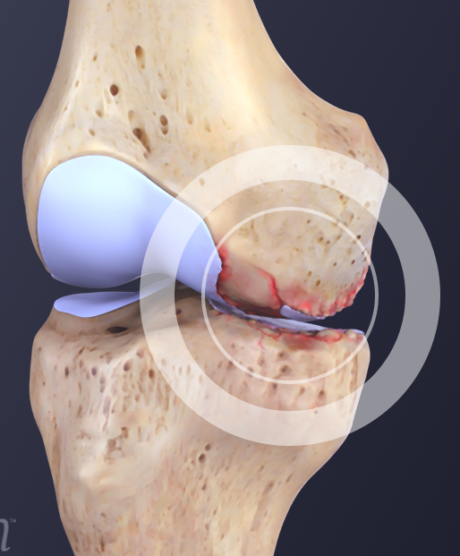
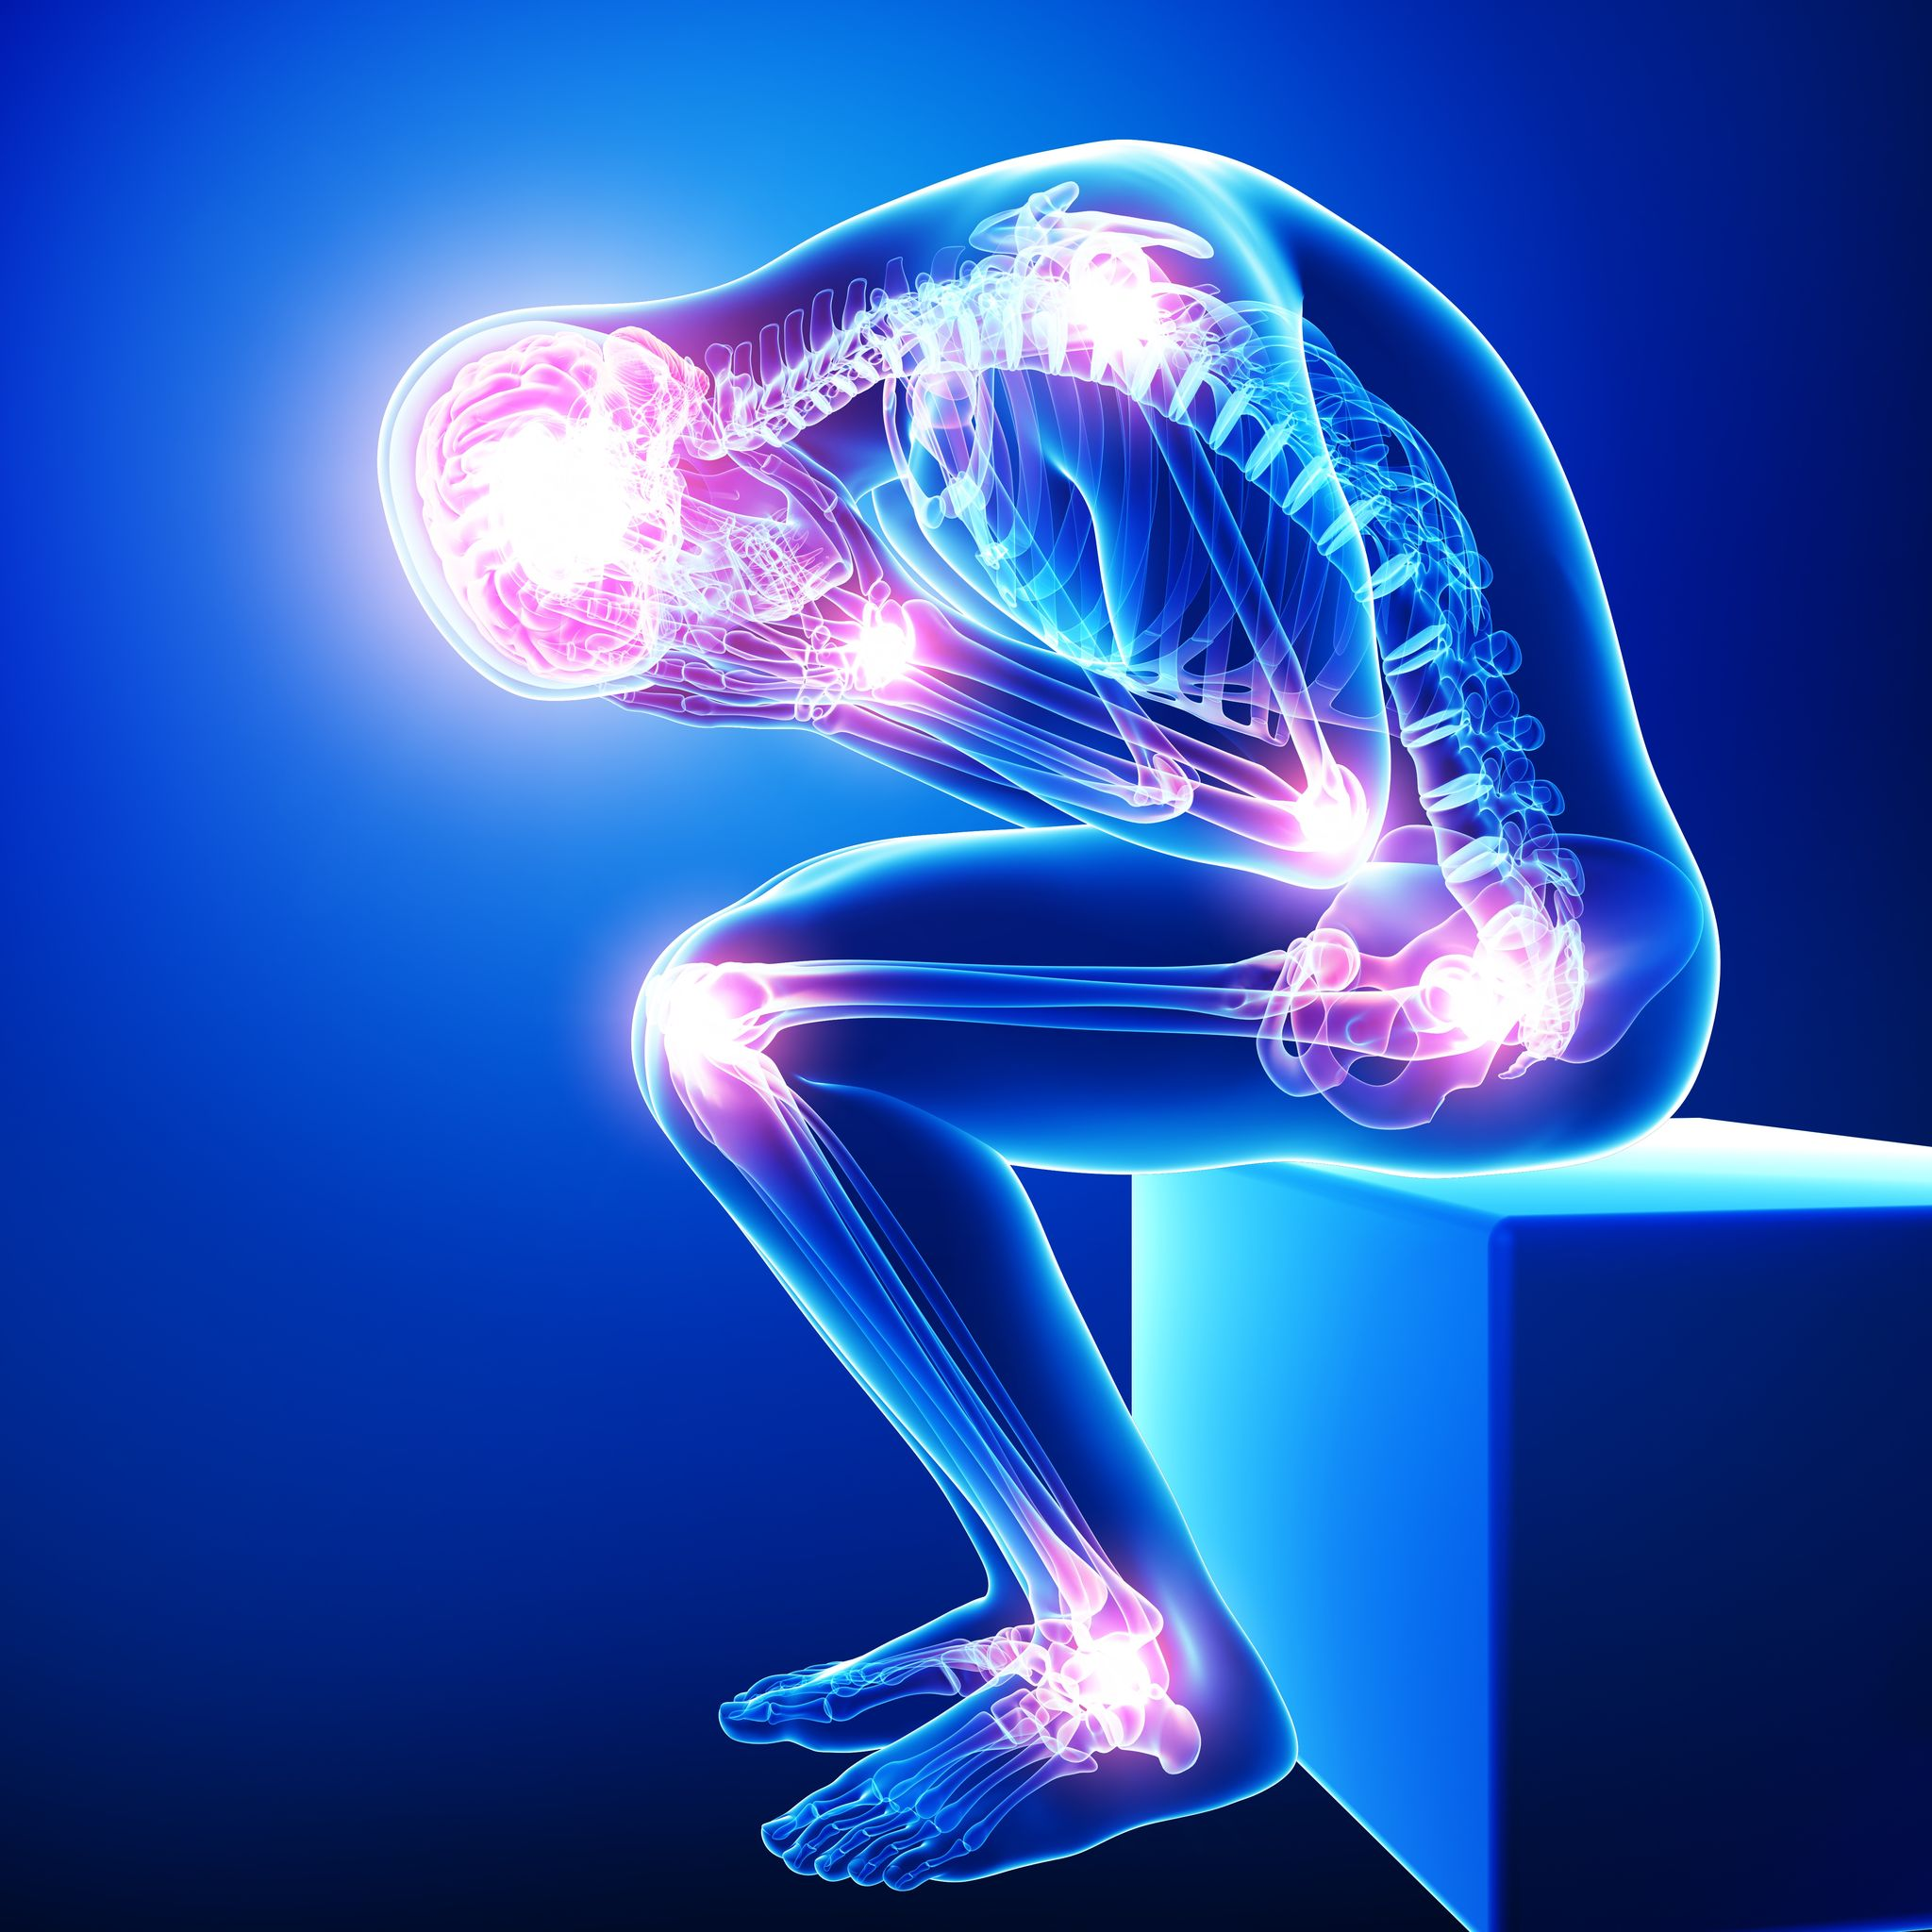


Slide 15


Slide 16
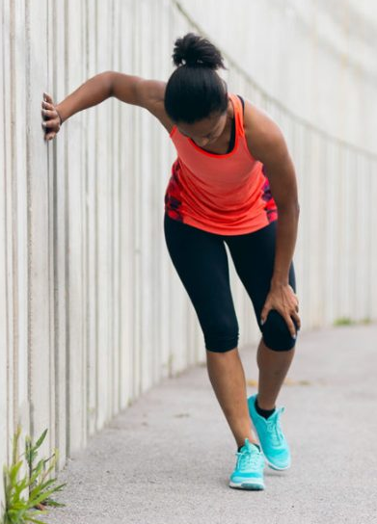


Slide 17
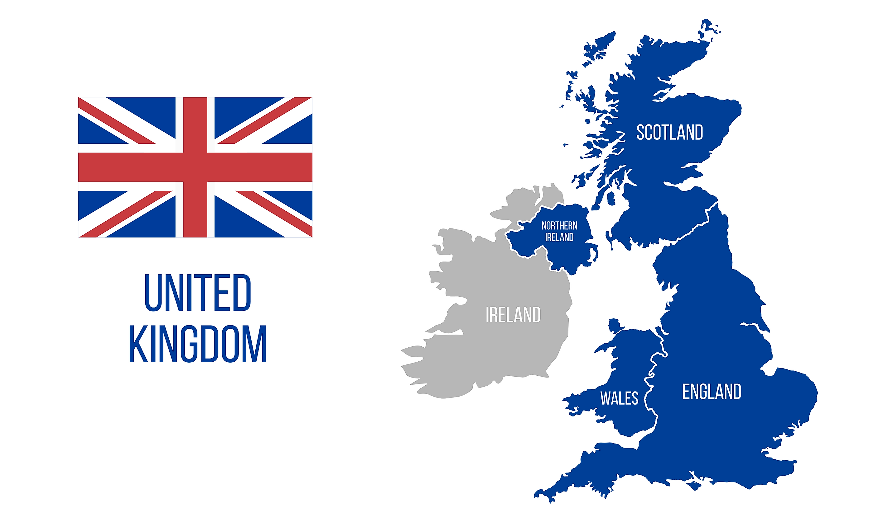

Slide 18
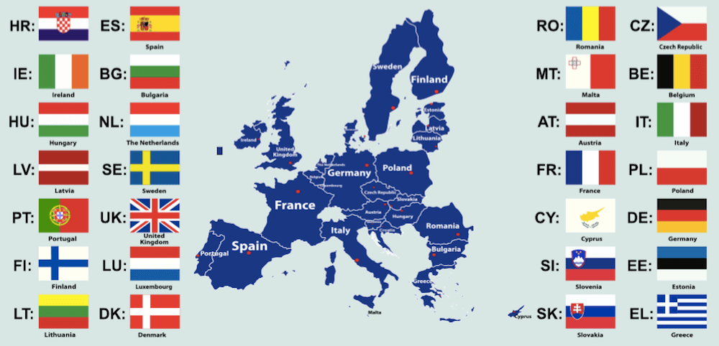

Slide 19
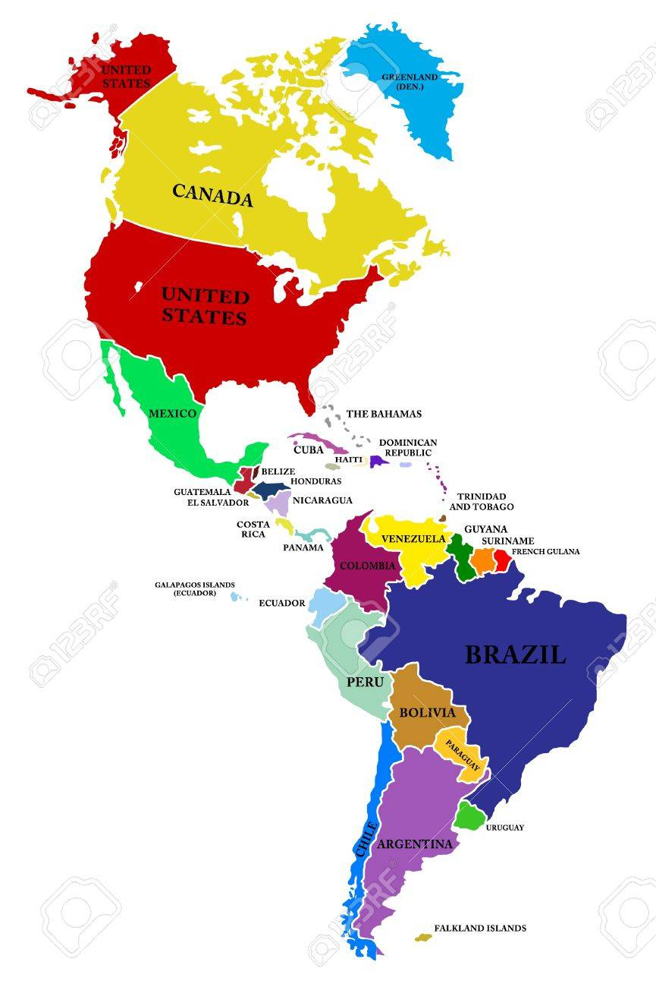
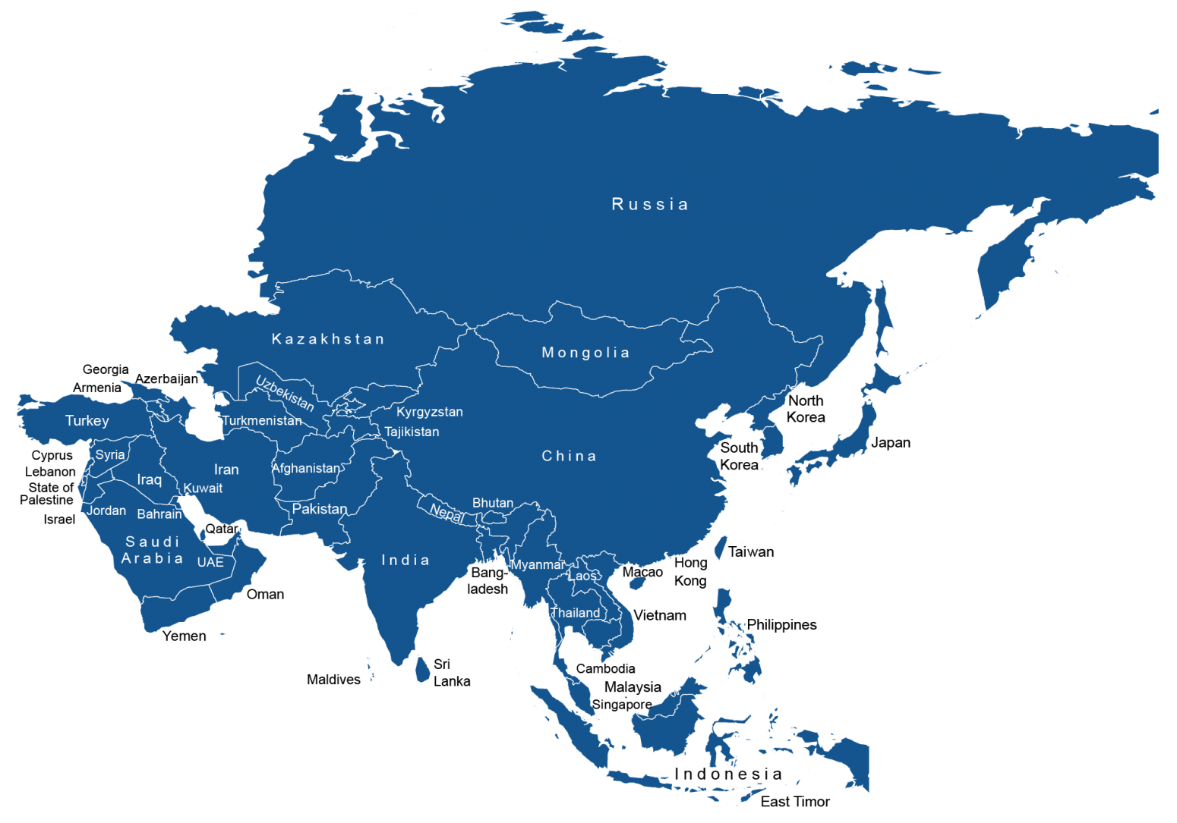

Slide 20


Slide 24
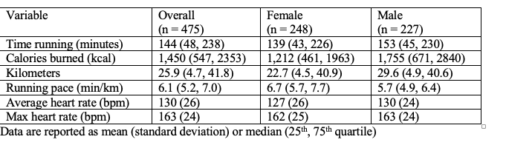

Slide 26
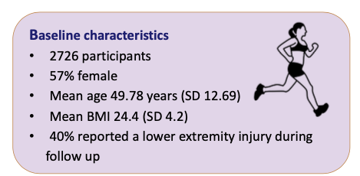

Slide 27
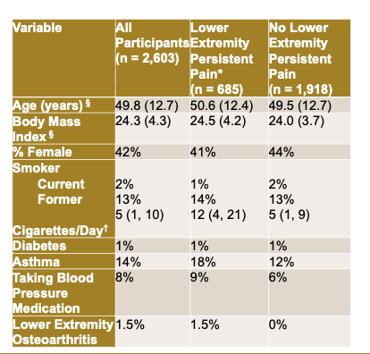

Slide 28
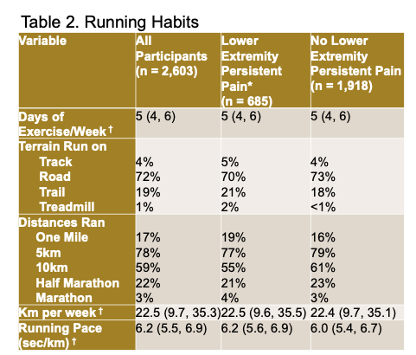

Slide 29
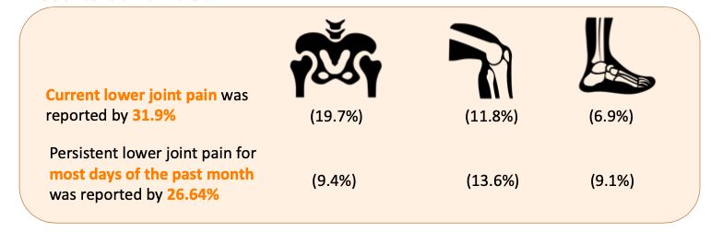
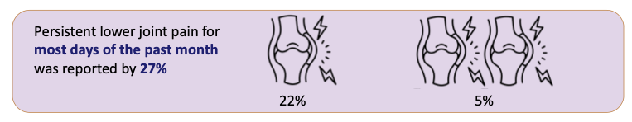

Slide 30
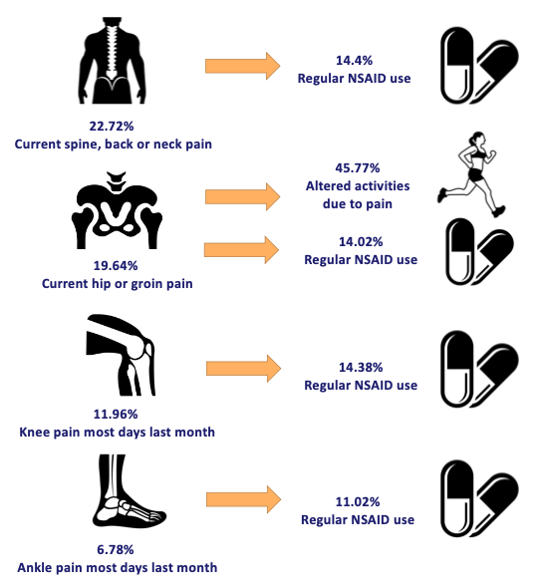

Slide 31
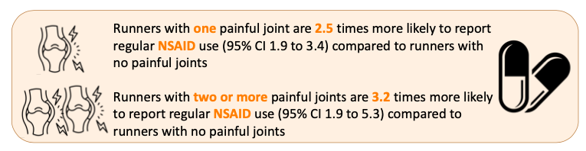

Slide 32
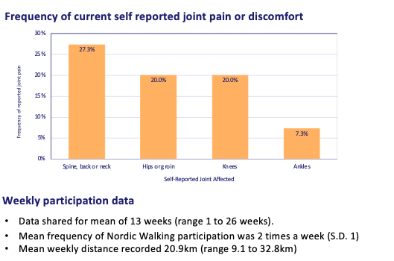
Nordic Walker Sub Cohort

Slide 33
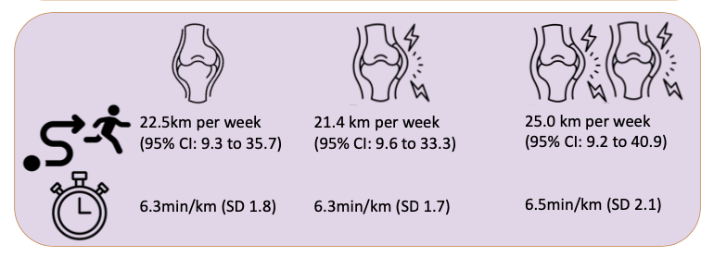

Slide 36
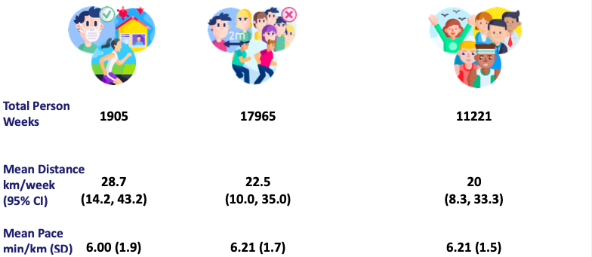
Running Habits During Lock-Down Phases

Slide 37
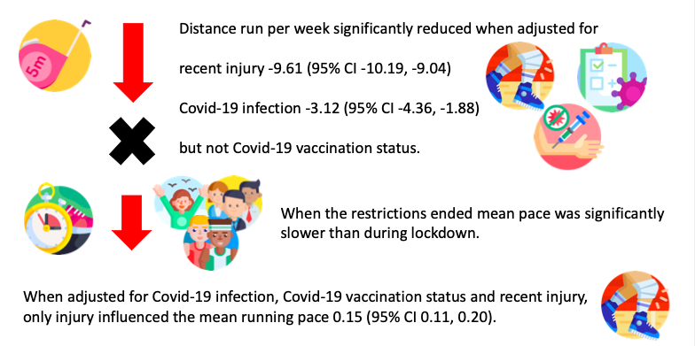

Slide 38
Take Home Messages
Despite Persistent Pain, Runners Still Found Ways to Run Similar Distances
  Soft Surfaces
  Increased NSAID Use
  Slow Paces
Older Nordic Walkers Reported Similar Trends in Pain and Compensation Strategies
Largest pain prevalence to low back
Largest persistent pain to knee
Shelter in Place Period People Ran One more Run per Week
COVID Vaccines did not decrease distance or speed of runs

Slide 39
https://runningthrough.org/

Slide 40
Park Run
https://blog.parkrun.com/uk/2021/03/24/research-on-running-through-covid-19/
Runner’s World
https://www.runnersworld.com/uk/news/a38879557/covid-19-running-through-study/
Trail Running Magazine
https://www.trailrunningmag.co.uk/articles/news/how-your-garmin-data-could-help-future-covid-sufferers/
Garmin
https://www.garmin.com/en-GB/blog/garmin-announces-support-of-university-of-nottingham-covid-19-runners-study/

Slide 41
gbullock@wakehealth.edu
@DRGSBullock

